Slide 1
ARRA Reporting – Upcoming Initiatives
Office of Contracts

Slide 2
Discussion Topics
Initiatives
  SiteXchange: Electronic Submission of C92s
  CRLMS: Electronic Submission of Certified Payrolls, Prevailing Wage Data
  Small Business Network
ARRA Reporting
  History, Lessons Learned from 1st Season
  Development of New Application

Slide 3
SiteXchange
Electronic Submission of C92s
Interface Similar to Expedite Bidding Software
Items Displayed, Indicate for Subs
Costs and Quantities as Bid Already Included

Slide 4
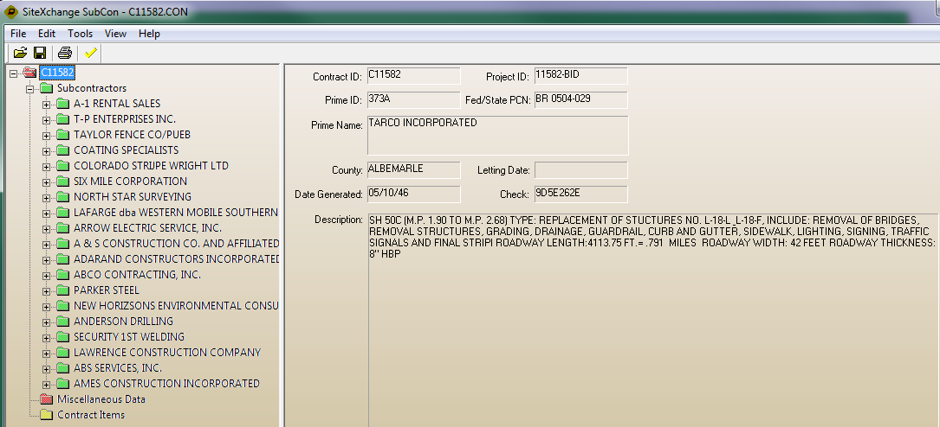
SiteXchange Interface

Slide 5
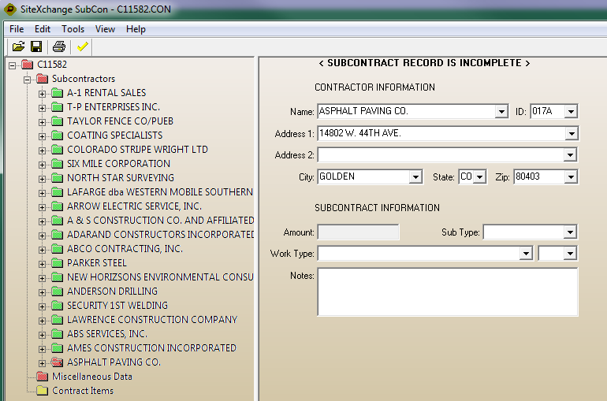
SiteXchange Interface

Slide 6
SiteXchange Functionality
Building Interface to Perform PQ Checks
Initially Diane Use SiteXchange for C92 Entry
  Fully Understand How It Works
  Work Out Any Issues

Slide 7
SiteXchange Pilot
Target End April for Pilot Implementation
Schedule with OCA
Volunteers to Pilot?
  Email tina.collins@dot.state.oh.us
Upon Implementation Hard Copy C92s No Longer Required

Slide 8
CRLMS
Online Submission of Certified Payrolls
Prevailing Wage Data Loaded
Contract Compliance Eased
Planning Stages
Meeting Next Thursday with InfoTech to Set Preliminary Schedule

Slide 9
ARRA Reporting
Initial Implementation Simple Form
Designed to Not Allow Edits
  Didn’t Anticipate Sheer Number of Edits
  Control of Data Submitted
  Edits Frequently Requested, Late Submission by Subs, District Finds Discrepancy
Significant Amount of Overhead to Manage

Slide 10
ARRA Reporting
Hard Copies to District Along with Online Submission
  Some Only Sending Hard Copies
  Others Only Submitting Online
  At Least One Did Not Submit at All
  Still Others Always Email Reports
Potential Auditing Issues

Slide 11
ARRA Reporting
Contractors No Access to What Submitted
Districts No Access to What Submitted
Individuals Submitting Unsure if Approved
Consistency Necessary
Eliminate Manual Overhead with Process
New Application Developed (Currently)

Slide 12
ARRA – New Reporting
Currently Developing New Application
Online Submission
  Eliminate Hard Copies to Districts
Online Approvals
Online Updates and Corrections
Consistent Data Store for Everyone
Target Date -> March Reporting Period

Slide 13
ARRA 1589
Customized To Do List
  Changes Based on User Logged In
Pull Last Month Entities, No Re-entry
Reporting Entity Submits Online
  Routes to District for Approval
  District Can Approve or Reject
  Approval to Central Office
  Rejection Back to Reporting Entity for Update

Slide 14
Updated 1589 Process
Primary Goal, Get In and Out of the Application with Minimal Effort
Personalized Queue/To Do List will Direct Users to Pending Items
  Not Submitted Forms
  Not Approved Forms
  Forms Under Review

Slide 15
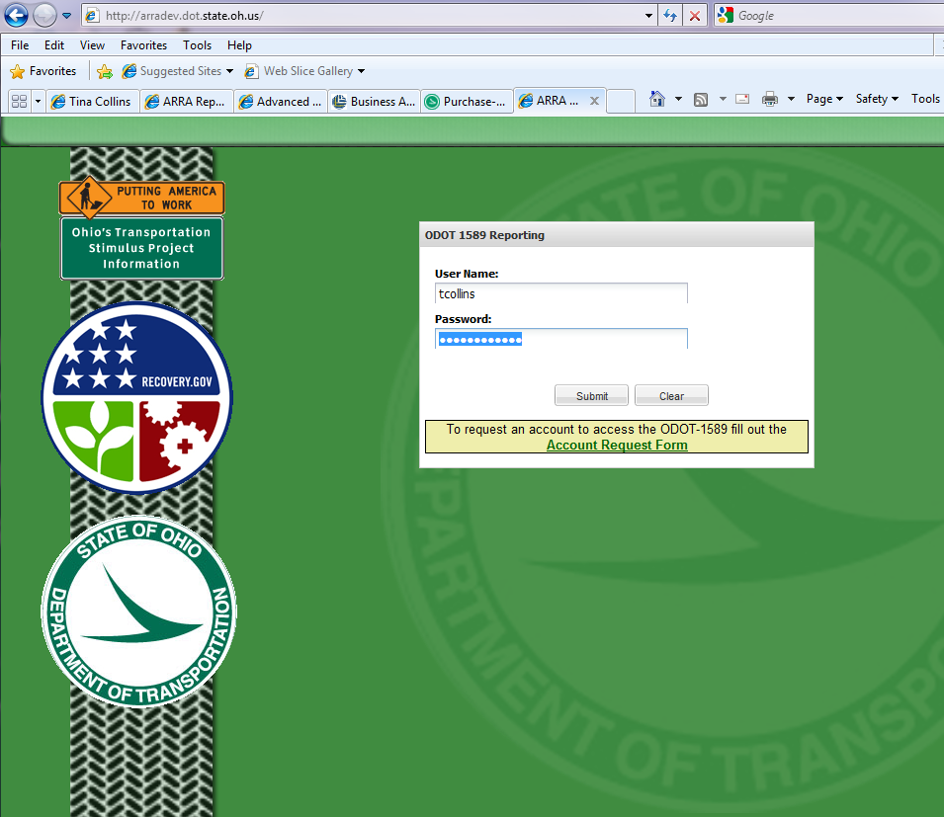
New

Slide 16
New Application
All Users Required to Login to Authenticate
  Ensure Data Reported from Intended Entity

Slide 17
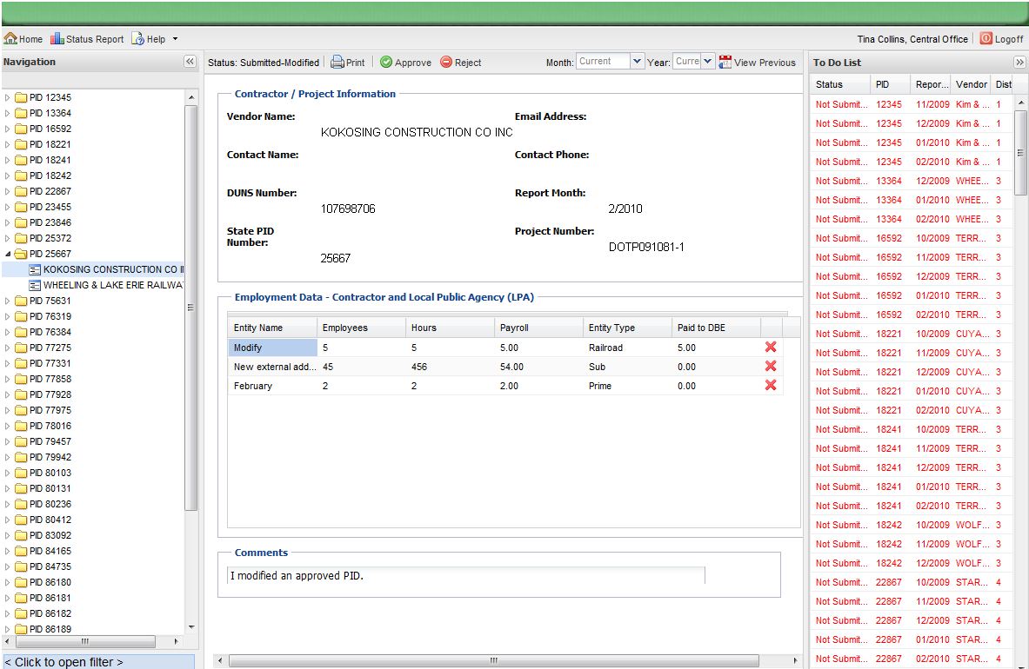

Slide 18
Questions?
  tina.collins@dot.state.oh.us
  614-466-2314

